Slide 1
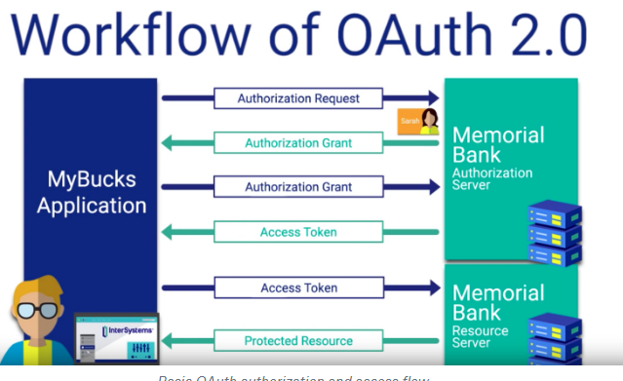
SI_507 OAuth & Caching
OAuth (Open Authorization)
https://www.youtube.com/watch?v=CPbvxxslDTU - required
An Open Standard in which users can grant permission to an App to access a web service for them (without giving passwords)
OAuth1
Original & still most popular
OAuth2
‘improved’
More authorization flows
Refreshes tokens
More complicated
Less secure

Slide 2
OAuth – basic steps
Oauth lets users grant an app permission to access an API for them – without sharing the username/password with the app
via API The App redirects user to an Authorization Server for login
API sends info back to app
App uses this info for access later.
This ‘info’ is Access Tokens and they can expire
Valid Access Token gives access to info for a given user.
Only available via authorization

Slide 3
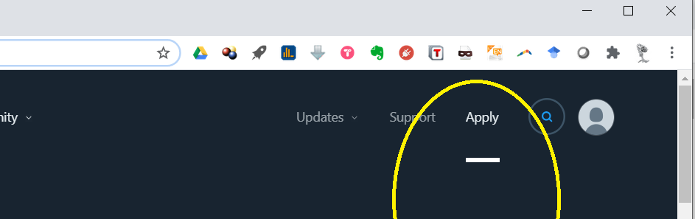
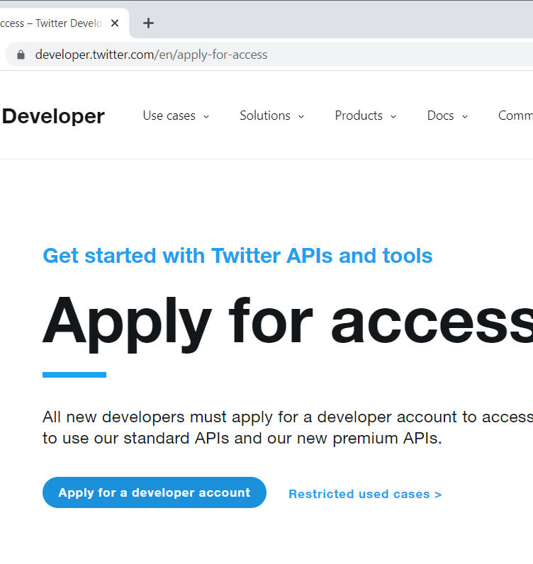
Example Twitter Do this NOW for next week’s HW 6
Create a Twitter Developer Acct
Create a twitter account
https://developer.twitter.com/en and apply for a developer account

Slide 4
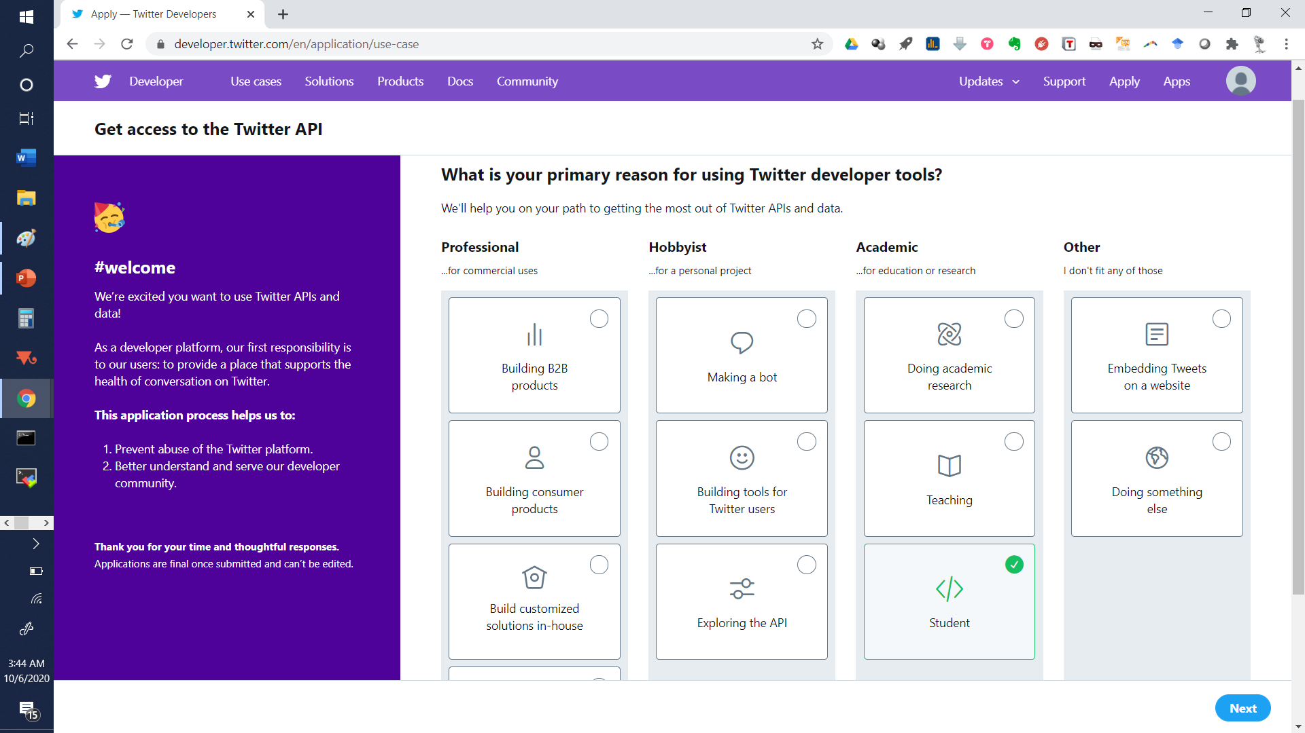
Make a student account

Slide 5
Further steps
Fill out the next page. Make sure you’re applying for an “Individual developer account.” If not, you probably did something weird on the previous page. Make sure to add an email address if you didn’t already or you won’t be able to complete the process.
Click Next when done and you’ll be transported to a page with many question banks.
Accept the Developer Agreement, Submit your Application & Check your email
In your words how will you use the Twitter API | I will be using the Twitter API in SI 507: Intermediate Programming at the University of Michigan, taught by Bobby Madamanchi According to Professor Newman, we will be using the Twitter API to learn the basics of Web APIs, API Keys, and JSON. We will build programs for use in course assignments that involve basic processing on Tweets (e.g., counting hashtags).
Are you planning to analyze Twitter Data | YES
How? | I will conduct basic analyses for educational purposes, including extracting and displaying fields from individual Tweets and doing simple aggregations such as counting hashtags from a feed.
Will your app use Tweet, Retweet, like, follow, or Direct Message functionality? | NO
Do you plan to display Tweets or aggregate data about Twitter content outside of Twitter? | YES
How? | Tweets and aggregate data will be displayed by text-based (command line) Python programs that will only be seen by the SI 507 instructional team.
Will your product, service or analysis make Twitter content or derived information available to a government entity? | NO

Slide 6
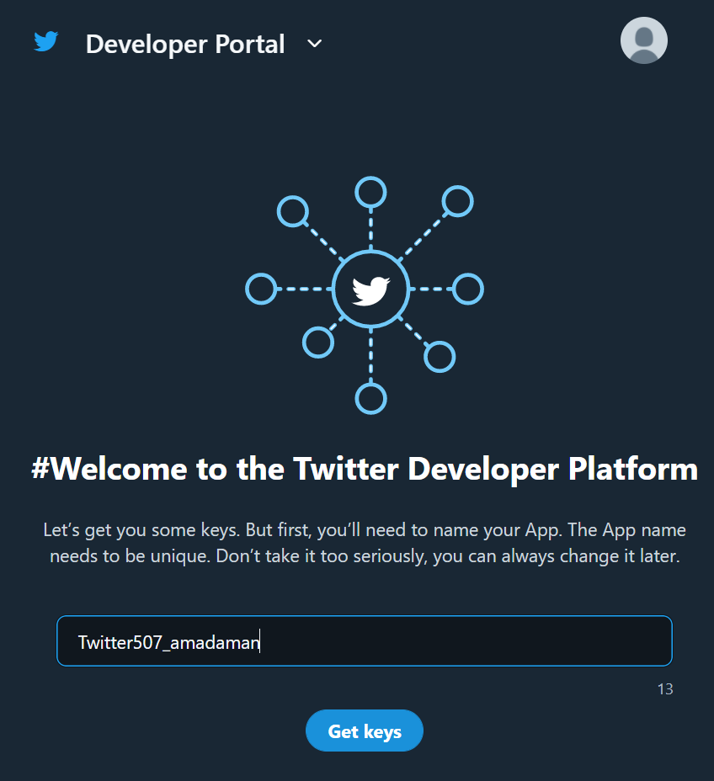
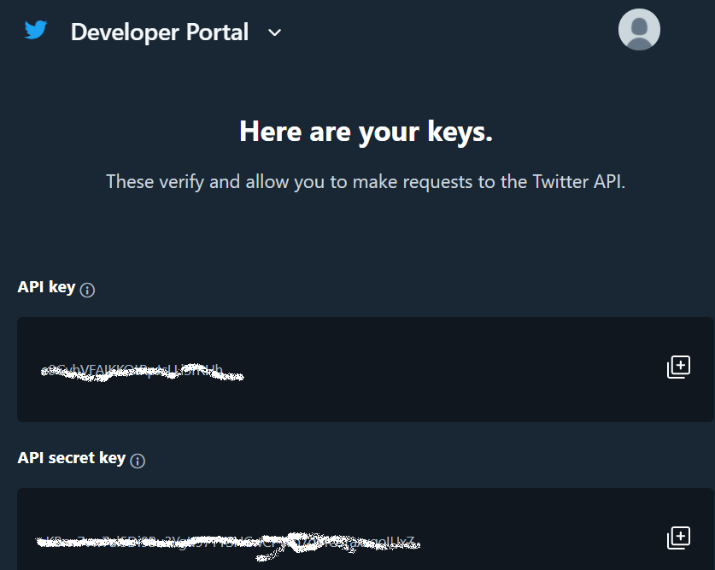
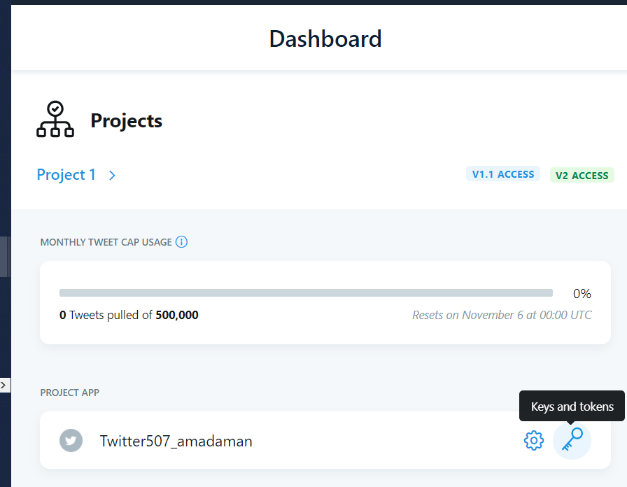
Create an App, Save Client Keys & Access Tokens
Create a unique name for your twitter app and get your keys & tokens
Navigate to https://developer.twitter.com/en/portal/dashboard to generate tokens
Save the keys that are visible in a secrets.py file

Slide 7
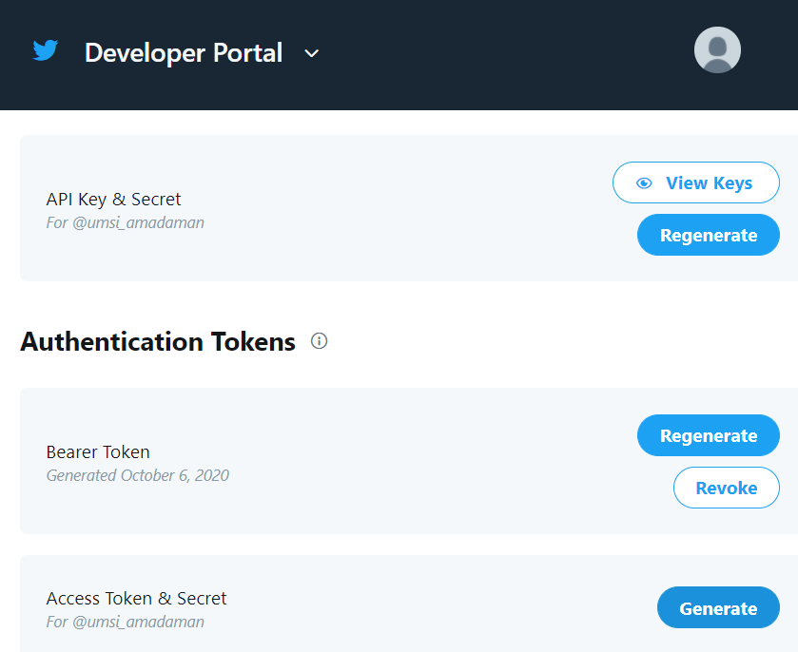
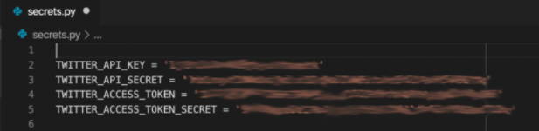
Generate Access Token Secret
Generate the Secret Token
save the tokens into secrets.py

Slide 8
Run twitter1.py
Install requests_oauthlib via pip (or pip3) install – worst case use google colab
Execute the script and the output should be 200
import json
import requests
from requests_oauthlib import OAuth1
import secrets
client_key = secrets.TWITTER_API_KEY
client_secret = secrets.TWITTER_API_SECRET
access_token = secrets.TWITTER_ACCESS_TOKEN
access_token_secret = secrets.TWITTER_ACCESS_TOKEN_SECRET
oauth = OAuth1(client_key,
client_secret=client_secret,
resource_owner_key=access_token,
resource_owner_secret=access_token_secret)
endpoint_url = 'https://api.twitter.com/1.1/search/tweets.json'
params = {'q': '@umsi'}
response = requests.get(endpoint_url,
params=params,
auth=oauth)
print (response.status_code)

Slide 9
Extend – print the tweets we will do this in week 8
Look at the JSON output
Check the docs https://developer.twitter.com/en/docs/twitter-api/v1/tweets/search/api-reference/get-search-tweets
Think about how you would do this.
The solution is provided in twitter2.py
If you didn’t figure out how to do this extension start by commenting the new lines in the solution – see if you can figure them out
Ask for explanation in lab or office hours!

Slide 10
Caching
Run the Fib.py file
def fib(n):
'''returns the nth number in the fibonacci sequence
'''
fib_seq = [0, 1]
for i in range(2, n):
fib_seq.append(fib_seq[i - 2] + fib_seq[i - 1])
return fib_seq[-1]
print (fib(300000)) # start with 100000 and increase until it's annoying
The computer can save time on static operations by saving the results of prior runs = caching
Look at Fib_Caching.py
FIB_CACHE = {} # define at module scope so it persists across fn calls
def fib_with_cache(n):
if n in FIB_CACHE.keys(): # is result for n already there?
return FIB_CACHE[n] # if so, look up result and return it
else: # cache miss!
FIB_CACHE[n] = fib(n) # do the operation and save the result
return FIB_CACHE[n] # return the newly saved result
Run the file and compare how much faster it is.

Slide 11
Persisting the Cache
A good cache is stored outside the program
The cache should be ‘serialized’ or converted into a format suitable for storage
That’s what JSON is for!
This can be done with two more functions found in Week6_PersistCache.py
CACHE_FILENAME = "cache.json"
def open_cache():
''' opens the cache file if it exists and loads the JSON into
the FIB_CACHE dictionary.
if the cache file doesn't exist, creates a new cache dictionary
Parameters
----------
None
Returns
-------
The opened cache
'''
try:
cache_file = open(CACHE_FILENAME, 'r')
cache_contents = cache_file.read()
cache_dict = json.loads(cache_contents)
cache_file.close()
except:
cache_dict = {}
return cache_dict
Try is good because it allows the program to continue if there isn’t a cache

Slide 12
Persisting the Cache 2
save_cache() converts the dictionary to JSON and saves it
def save_cache(cache_dict):
''' saves the current state of the cache to disk
Parameters
----------
cache_dict: dict
The dictionary to save
Returns
-------
None
'''
dumped_json_cache = json.dumps(cache_dict)
fw = open(CACHE_FILENAME,"w")
fw.write(dumped_json_cache)
fw.close()

Slide 13
Caching with Web APIs
Working with Web APIs can be expensive (time, computing power or even $$$)
Caching lowers costs – especially during development
What keys should we use for storing & retrieving our requests?
URL = Universal Resource Locator
Remember APIs could be accessed via URL?
Inherently unique and specific to our requests
https://api.twitter.com/1.1/search/tweets.json?q=@umsi
endpoint_url = 'https://api.twitter.com/1.1/search/tweets.json’
params = {'q': '@umsi’}
response = requests.get(endpoint_url, params=params, auth=oauth)
How can we programmatically generate unique keys (URLs)
See if you can write a function to do this?

Slide 14
Caching with Web APIs – Generating Unique Keys
To clarify we don’t need a functioning URL
therefore we don’t have to bother with & and = and ?
Lets just use _
def construct_unique_key(baseurl, params):
param_strings = []
connector = '_'
for k in params.keys():
param_strings.append(f'{k}_{params[k]}')
unique_key = baseurl + connector + connector.join(param_strings)
return unique_key
The join() concatenates strings

Slide 15
Querys don’t care about Parameter order
So we must alphabetize our parameters to standardize the key construction
def construct_unique_key(baseurl, params):
param_strings = []
connector = '_'
for k in params.keys():
param_strings.append(f'{k}_{params[k]}')
param_strings.sort()
unique_key = baseurl + connector + connector.join(param_strings)
return unique_key
This function can be called with the following example
endpoint_url = 'https://api.twitter.com/1.1/search/tweets.json'
params = {'q': '@umsi', 'count':'100', ‘lang’: ‘en'}
print(construct_unique_key(endpoint_url, params))

Slide 16
Extension
Can you modify twitter2.py to use caching?
Using the caching approach we just discussed – what would need to modified?
Think big picture in terms of pseudocode before writing actual commands
We will do this in class next week!

Slide 17
Extension
Can you modify twitter2.py to use caching?
“Wrapping” the call to requests.get() with a function that checks in the cache first before sending out the request.
Saving the cache to disk whenever it changes
Loading the cache from disk when the program starts
Including the construct_unique_key() function to uniquely identify each request by its base URL and set of parameters.

Slide 18
Extension
Skeleton Code Skeleton.py
Solution Solution.py
If you weren’t able to solve the problem – make sure you annotate the solution code to help you internalize this process
We will go over this in class next week!

